Slide 1
Infinite Runner (2D)
By: Dougey Goslin

Slide 2
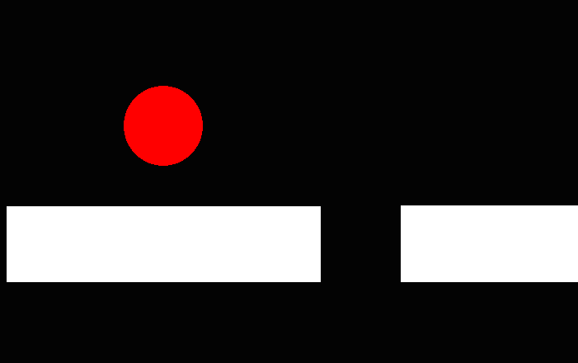
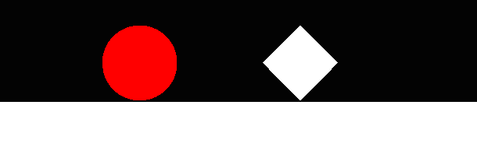
Infinite Runner (2D)
The point of the game is to try to survive as long as you can without hitting the objects
2D Side-Scroller moving to the right
Made in Unity
Watch OUT!

Slide 3
Now for THE actual Game…

